Slide 1

JUHI ARTZ
PINE PARADISE
Eco Hanging Lights
Pine’s Inner beauty unearthed
for the first time in the world
Notes:
The world has so far seen pine wood used in making cottages, floorings, packaging, etc. Juhi Artz has created Pine Paradise comprising innovative designs in lighting fixtures of all types such as lamps and shades, floor lamps, chandeliers, wall lights, hanging lights, etc.
Juhi Artz, in 2013, ventured successfully for an innovative change in contemporary use of pinewood in an innovative manner. It has conceptualized various attractive designs using pinewood in a novel manner. Juhi Artz has tried to show the inner beauty of pinewood reflected through its intriguing mosaic patterns in its products with glitzy and warm effect. It is truly emerging as a trend-setter for pinewood lighting fixtures. Juhi Artz is committed to its craftsmanship and high quality products.
With a comprehensive pinewood product line and a team of creative designers, technicians and highly skilled artisans standing by to customize its designs to clientele’s specific needs. Juhi Artz can provide the perfect and innovative lighting solutions to any settings such as drawing/dining room, bedroom, kids room, kitchen, etc. Moreover, the exclusive products can also cater well to the hospitality and wellness industry.

Slide 2
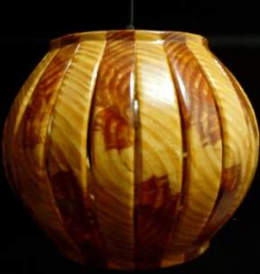
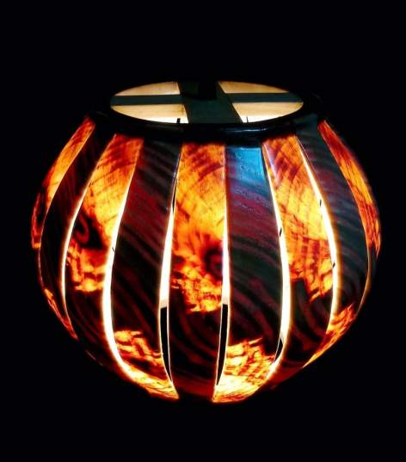
Spherical Slitz Hanging
1

Slide 3
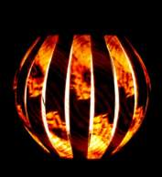
Multi-spherical Slitz Hanging or floor lamps
2

Slide 4
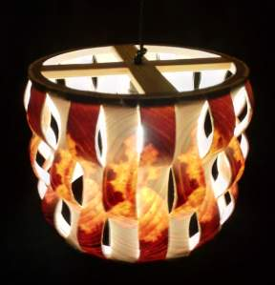
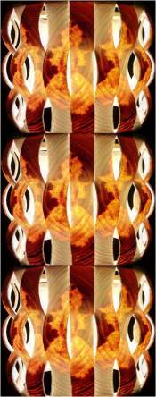
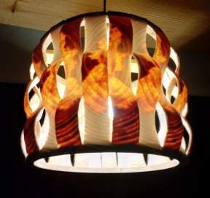
Wavy RectoVerso Hanging or floor lamp
3

Slide 5
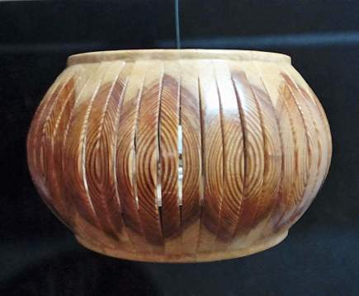
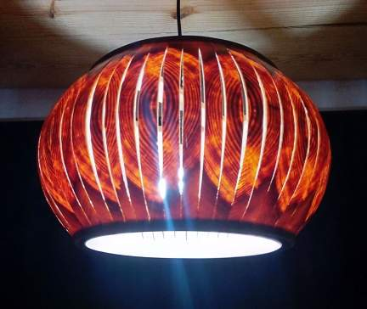
Globular Slitz Hanging
4

Slide 6
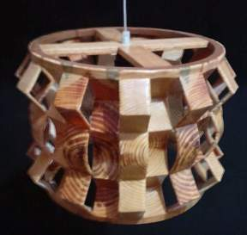
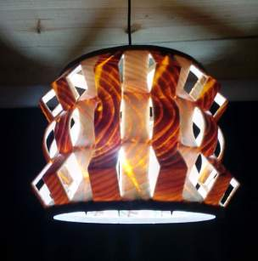
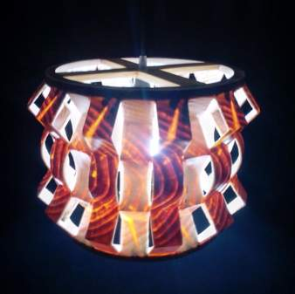
ZigZag Round RectoVerso Hanging
5

Slide 7
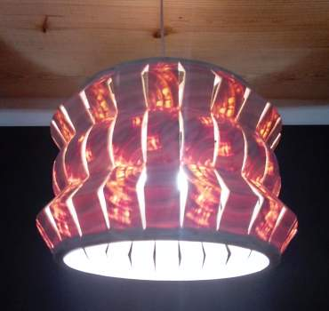
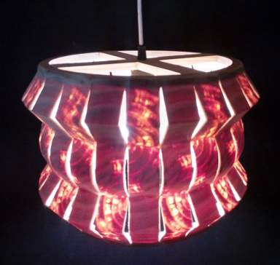
ZigZag Round Hanging
6

Slide 8
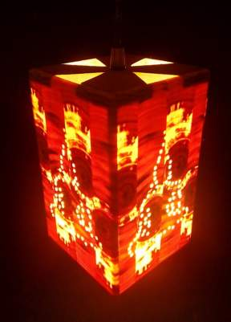
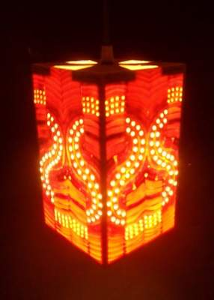
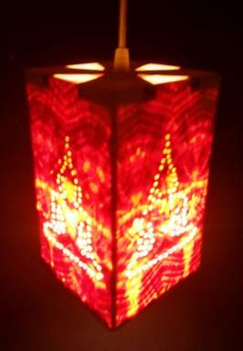
Perfo Buddha and other Hanging
7

Slide 9
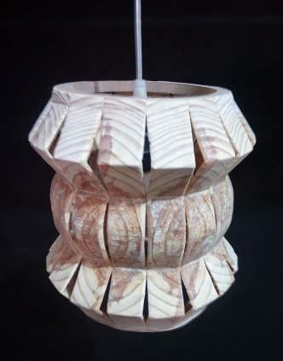
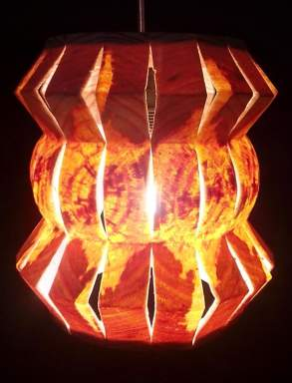
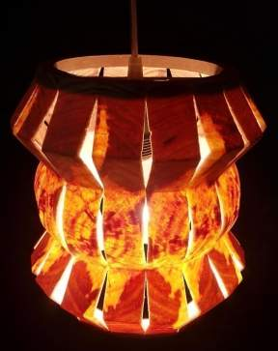
ZigZag Round small Hanging
8

Slide 10
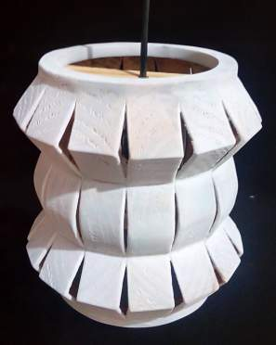
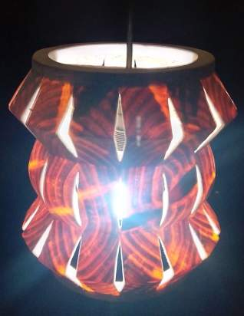
ZigZag Round White stained small hanging
9

Slide 11
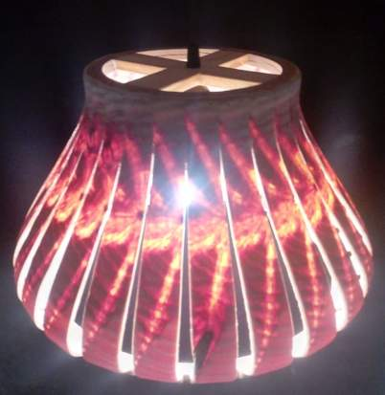
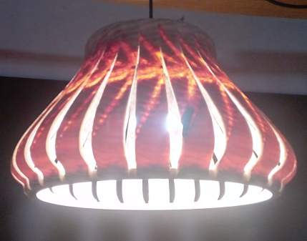
Bell-shape Slitz Hanging
10

Slide 12
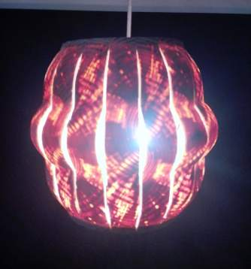
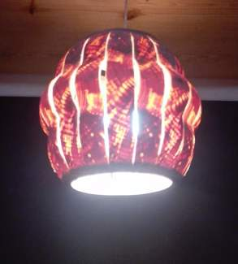
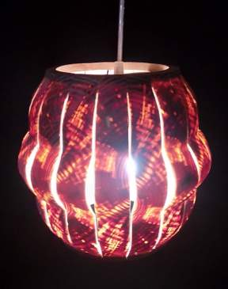
Dholak Slitz small Hanging
11

Slide 13
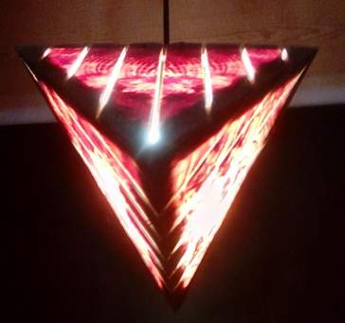
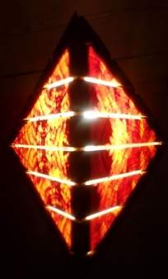
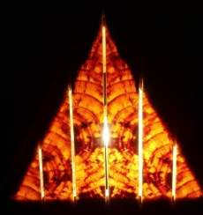
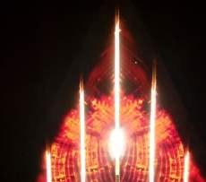
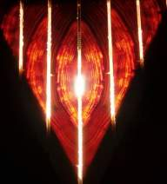
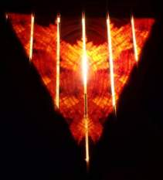
Four Triangular Pyramid Hanging
12
Bottom view
Four Sides

Slide 14
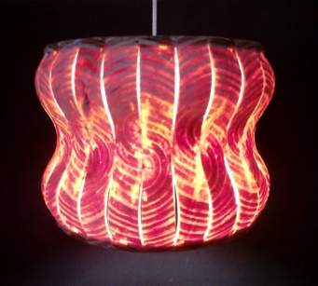
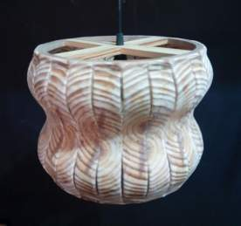
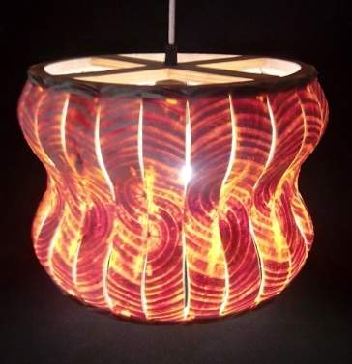
Wavy Large Hanging
13

Slide 15
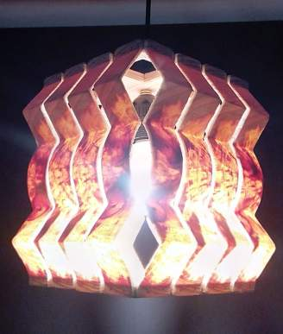
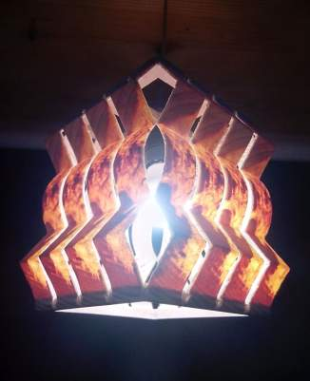
ZigZag Round Square Hanging
14

Slide 16
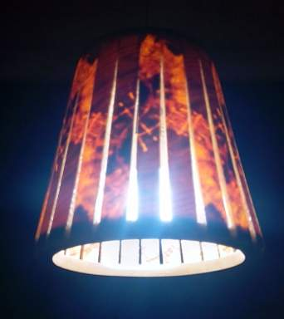
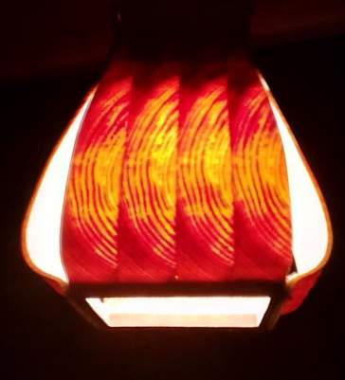
Conical Slitz small Hanging
15
Square Hanging Fanoos
16

Slide 17
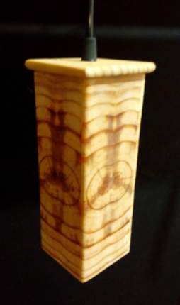
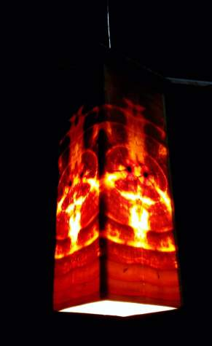
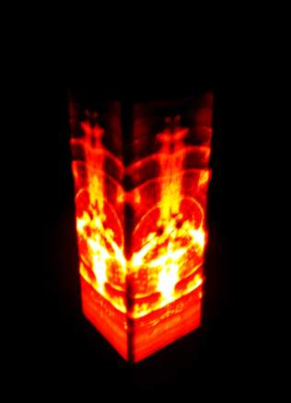
Tubular small hanging
17

Slide 18
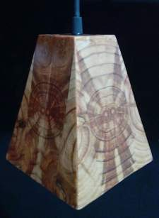
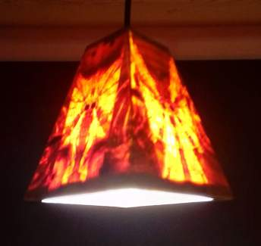
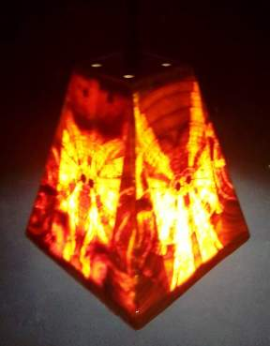
Triangular small hanging
18

Slide 19
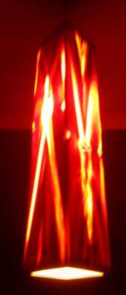
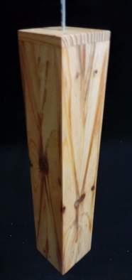
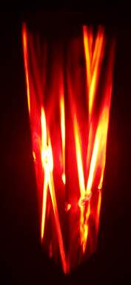
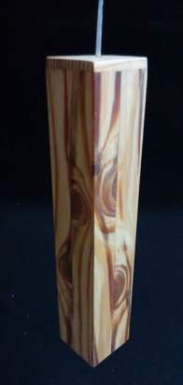
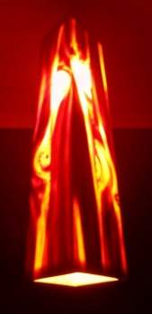

Tubular Sleek hanging
19

Slide 20


Drum hanging Medium
20
Small Cylindrical Hanging
21

Slide 21

Four arches Hanging
22

Slide 22

Square Perfo Hanging
23

Slide 23


Cylindrical small Hanging
24

Slide 24


Square Box Hanging
25

Slide 25

Six arches Hanging
26

Slide 26

Octa small Hanging
27

Slide 27

Cylindrical Hanging Medium
28

Slide 28

Cylindrical Hanging med. curvy edges
29

Slide 29
ECO Wooden
Table Lamps

Slide 30


Conical curvy Table Lamp
30

Slide 31


Cylindrical Conc. Table lamp
31

Slide 32


Square Conc. Table lamp
32

Slide 33


Octa Curvy small Table lamp
33

Slide 34


Spherical Slitz Table lamp
34
Dholak Table lamp med.
35

Slide 35

ZigZag Round Table lamp
36

Slide 36




Conical small slitz Table lamp
37
Square Pyramid Table lamp
38

Slide 37


Square Pyramid Large Table lamp
39

Slide 38
ECO Wooden
Table Top & Hanging Lamps

Slide 39



Hexa Flower Tabletop lamp or hanging flower lamp
40

Slide 40




Zigzag Round Small Sq Tabletop lamp
41
Zigzag Round Hexa Tabletop lamp
42

Slide 41


Perfo Buddha and other Tabletop lamps
43

